Slide 1
Recurrent Feature Reasoning for Image Inpainting
CVPR 2020
Jingyuan Li, Ning Wang, Lefei Zhang, Bo Du, Dacheng Tao
报告人：贺蕴
学号：20210240010

Slide 2
Motivation
Filling in large continuous holes remains difﬁcult: correlations are weakened and the constraints for the hole center loosen
Recurrent Feature Reasoning(RFR) module: recurrently infers the hole boundaries of the convolutional feature maps and then uses them as clues for further inference
Knowledge Consistent Attention (KCA) module: capture information from distant places in the feature map for RFR

Slide 3
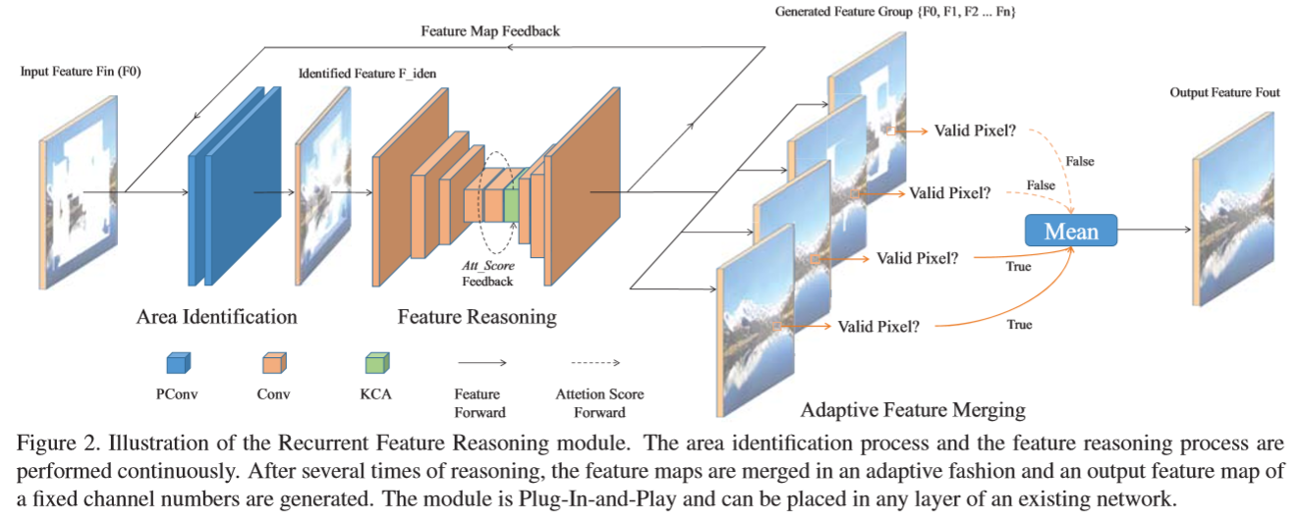
Recurrent Feature Reasoning Module

Slide 4
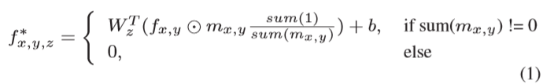
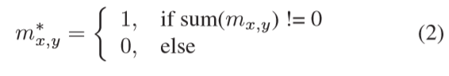
Area Identiﬁcation: Partial Convolution
We deﬁne the difference between the updated masks and the input masks as the areas to be inferred in this recurrence

Slide 5
Feature Reasoning
Simply stack a few encoding and decoding layers and bridge them using skip connections
The updated mask and the partially inferred feature maps are directly sent to the next recurrence

Slide 6
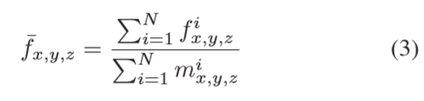
Feature Merging
The values in the output feature map are only calculated from the feature maps whose corresponding locations have been ﬁlled

Slide 7
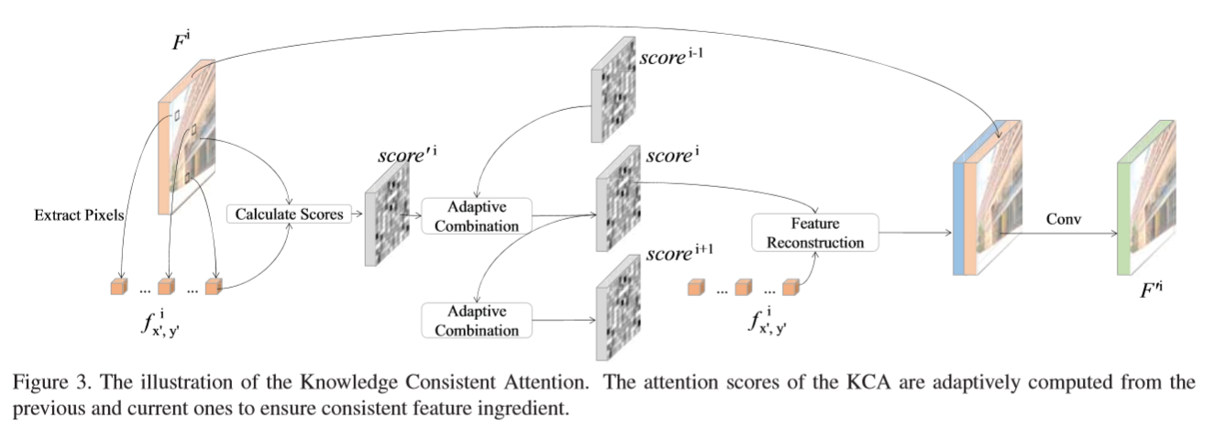
Knowledge Consistent Attention

Slide 8
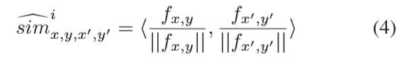
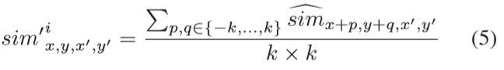

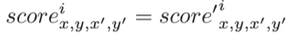
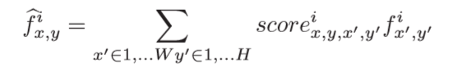
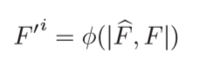
Knowledge Consistent Attention
cosine similarity :
smooth the attention scores :
use the softmax function
(x,y) is valid :
(x,y) is not valid :
new feature map :

Slide 9
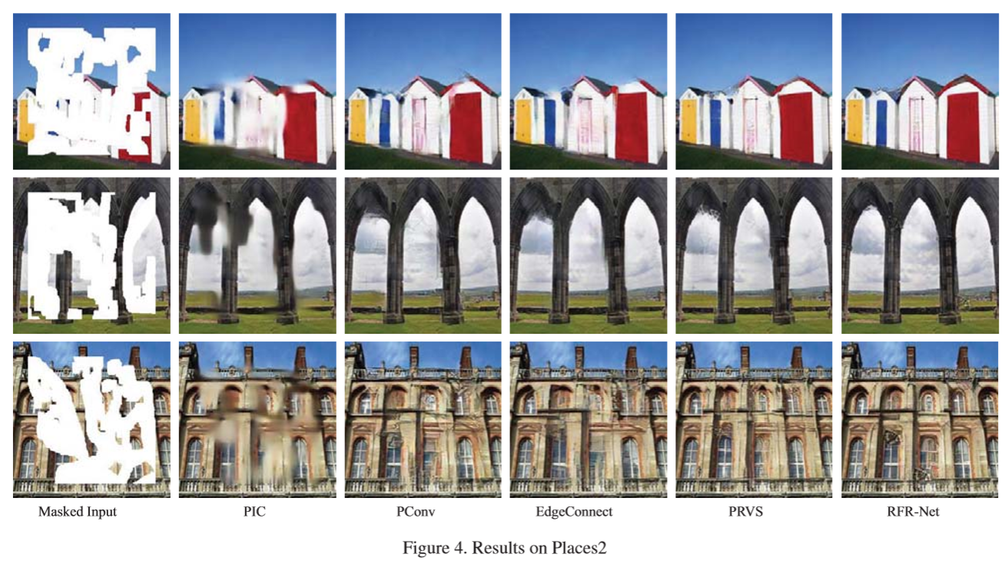
Qualitative Comparisons

Slide 10
Free-Form Image Inpainting with Gated Convolution
ICCV 2019 Oral
Jiahui Yu, Zhe Lin, Jimei Yang, Xiaohui Shen, Xin Lu, Thomas Huang

Slide 11
Motivation
The proposed gated convolution solves the issue of vanilla convolution that treats all input pixels as valid ones, generalizes partial convolution by providing a learnable dynamic feature selection mechanism for each channel at each spatial location across all layers

Slide 12
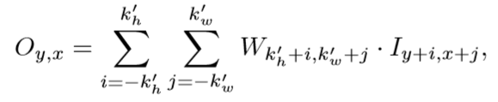
Vanilla Convolutions
The equation shows that for all spatial locations (y,x), the same ﬁlters are applied
However, for image inpainting, the input are composed of both regions with valid pixels/features outside holes and invalid pixels/features (in shallow layers) or synthesized pixels/features (in deep layers) in masked regions.

Slide 13
Partial Convolutions
The mask in next layer will be set to ones no matter how many pixels are covered by the ﬁlter range in previous layer
Partial convolution can be viewed as un-learnable single-channel feature hard-gating

Slide 14
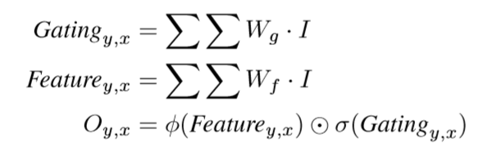
Gated Convolutions
Instead of hard-gating mask updated with rules, gated convolutions learn soft mask automatically from data

Slide 15
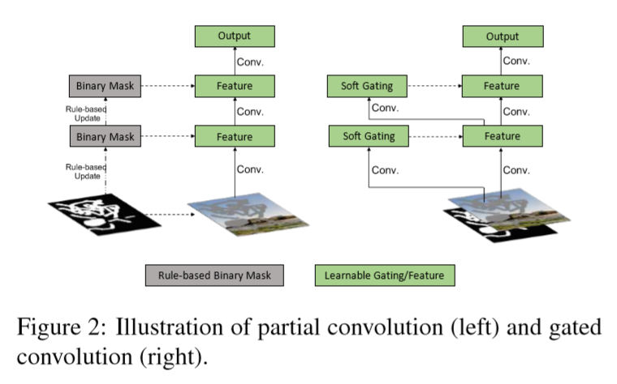
Gated Convolutions

Slide 16
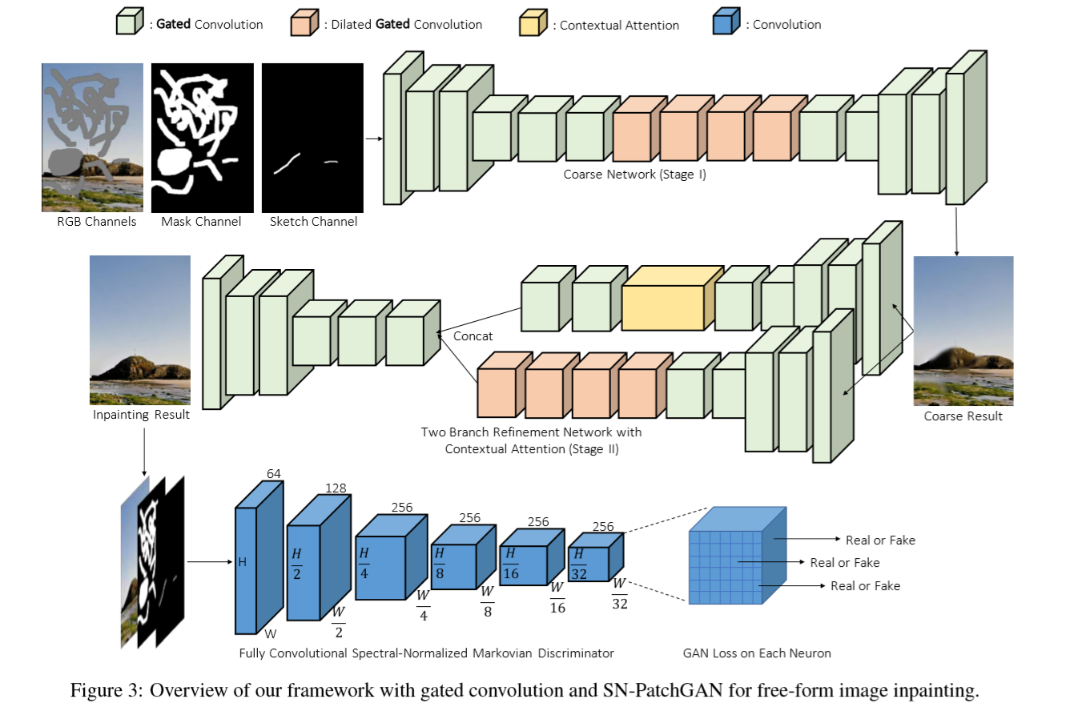
Framework

Slide 17
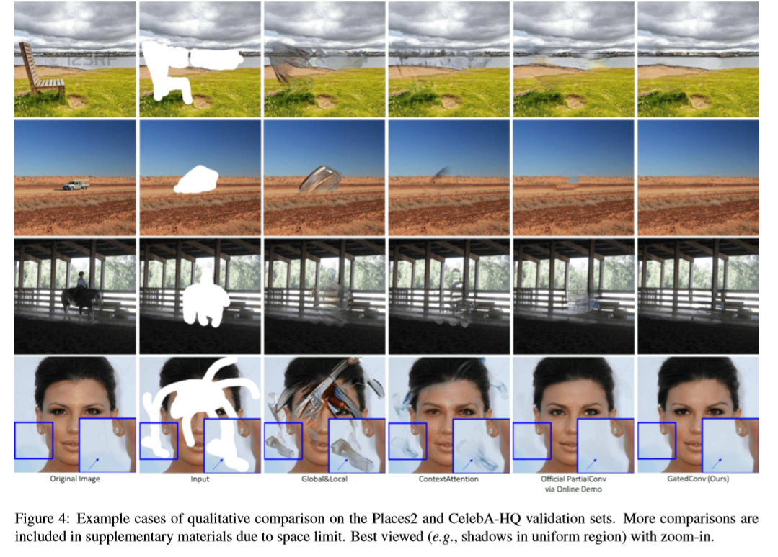
Qualitative Comparisons

Slide 18
Contextual Residual Aggregation for Ultra High-Resolution Image Inpainting
CVPR 2020 Oral
Zili Yi, Qiang Tang, Shekoofeh Azizi, Daesik Jang, Zhan Xu

Slide 19
Motivation
Recently data-driven image inpainting methods can only handle low-resolution inputs due to memory limitations
Naive up-sampling of the low-resolution inpainted result can merely yield a large yet blurry result. Whereas, adding a high-frequency residual image onto the large blurry image can generate a sharp result
We propose a Contextual Residual Aggregation (CRA) mechanism that can produce high-frequency residuals for missing contents, thus only requiring a low-resolution prediction from the network

Slide 20
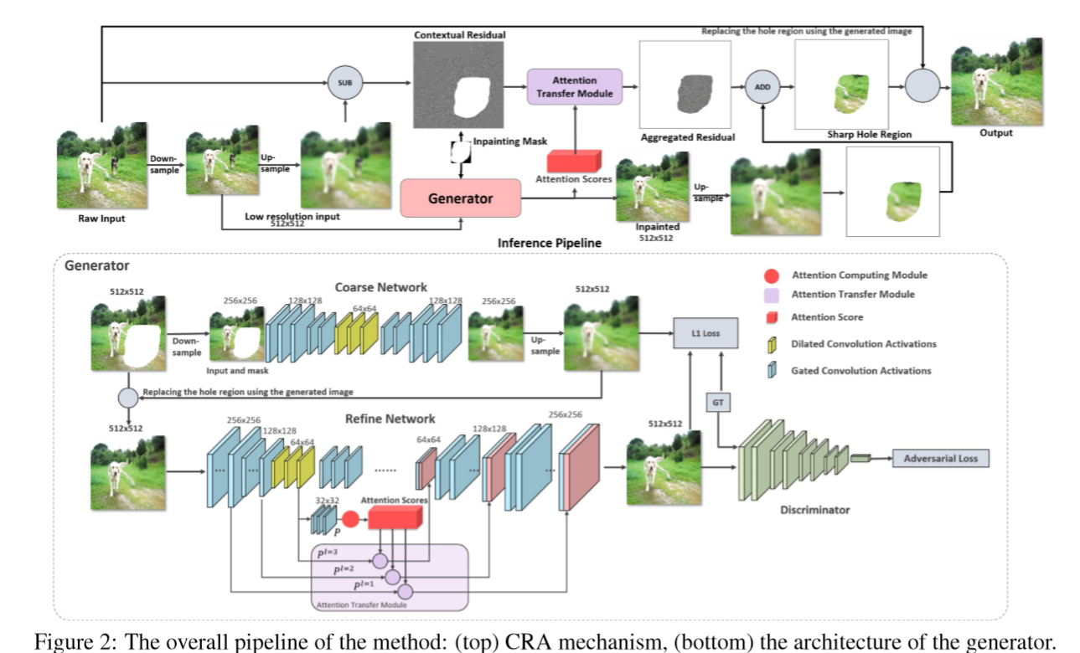
The Overall Pipeline

Slide 21
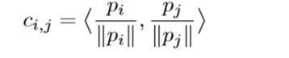
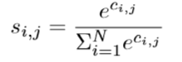
Attention Computing Module (ACM)
P is divided into patches and ACM calculates the cosine similarity between patches inside and outside missing regions :
Softmax is applied on the similarity scores to obtain the attention scores for each patch:

Slide 22
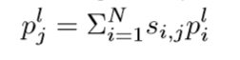
Attention Transfer Module (ATM)
The corresponding holes in the lower-level feature maps can be ﬁlled with contextual patches weighted by the attention scores:
As the size of feature maps varies by layer, the size of patches should vary accordingly

Slide 23
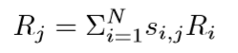
Residual Aggregation
The residuals for the missing contents can be calculated by aggregating the weighted contextual residuals obtained from previous steps :

Slide 24
Architecture of Generator
We use a two-stage coarse-to-ﬁne network architecture where the coarse network hallucinates rough missing contents, and the reﬁne network predicts ﬁner results
Reﬁne network computes contextual attention scores with a high-level feature map and performs attention transfer on multiple lower-level feature maps

Slide 25
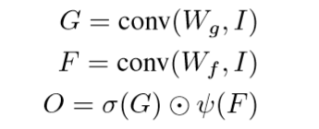
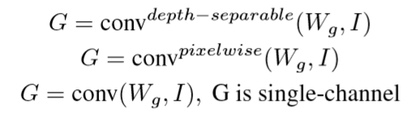
Light Weight Gated Convolution
The depth-separable LWGC employs a depth-wise convolution followed by a 1 × 1 convolution to compute gates
The pixelwise LWGC uses a pixelwise or 1×1 convolution to compute the gates
The single-channel LWGC outputs a single-channel mask that is broadcast to all feature channels during multiplication

Slide 26
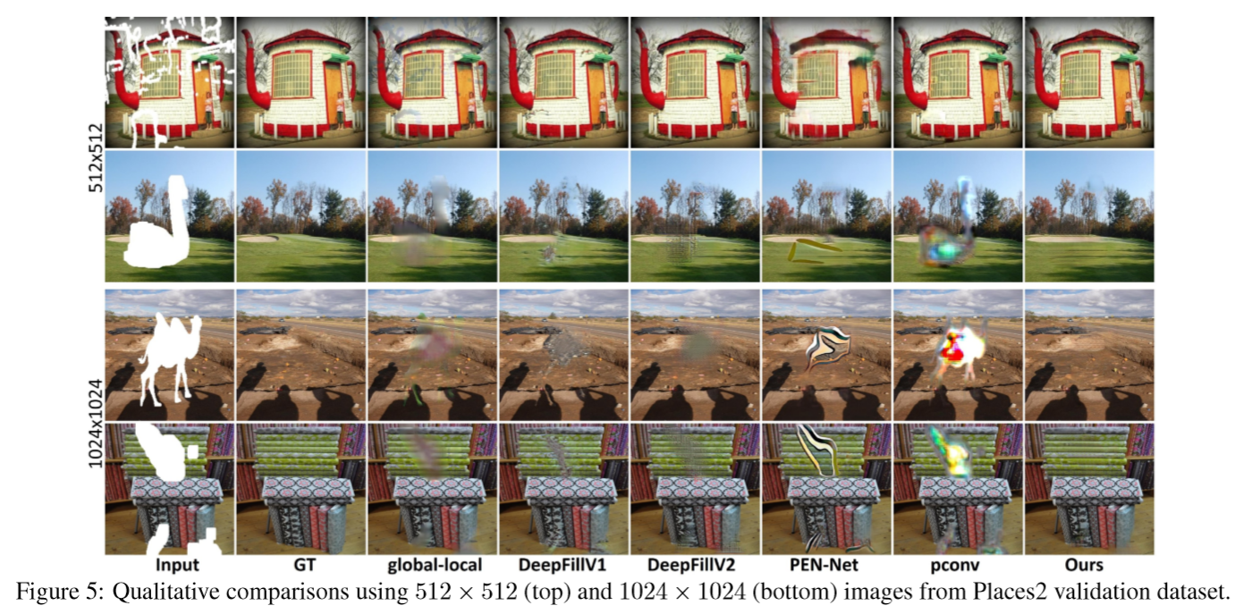
Qualitative Comparisons

Slide 27
THANK YOU!

